Slide 1





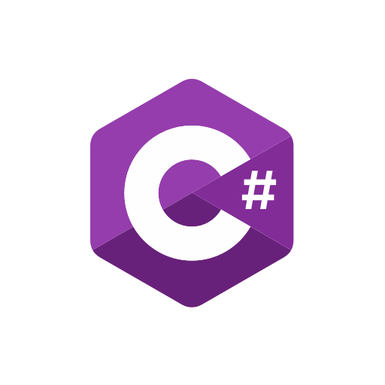

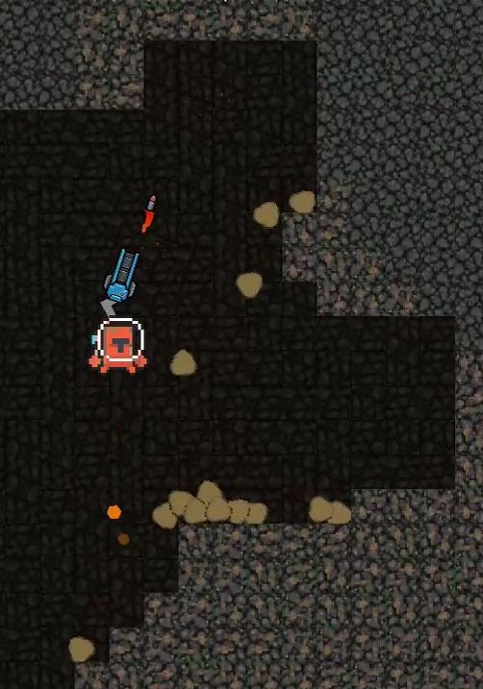
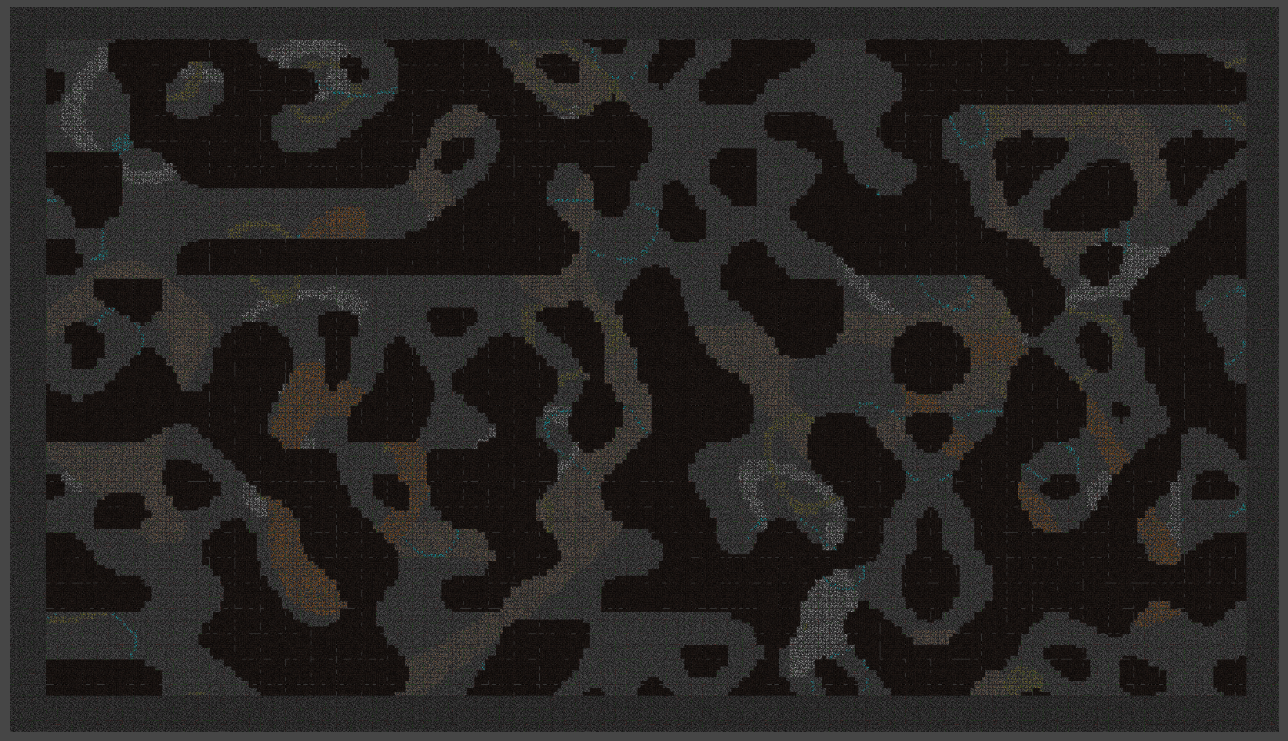
Cavebound (Crypto-Miner) Andrew Greenslade : https://www.linkedin.com/in/andrew-greenslade andrew@greensladegames.com AndrewGreenslade : https://github.com/AndrewGreenslade
1. Introduction:
2. Project objective
Cryptocurrency and NFTs as a reward in games are both widely unexplored mechanisms up to this date. There has been a small investment from mainstream studios, e.g. Ubisoft with ‘Ubisoft quartz’, where you could unlock limited access NFTs that would reward the player with unique game items. This leaves an upcoming market for various ways to integrate these two technologies into the industry. I aim to implement a similar system into my game called Cavebound, which is a procedurally generated 2D mining game built from the ground up around this system.
With this project, I aim to look at different ways of integrating NFT and cryptocurrency technologies into games and choose to integrate one method into this project that I have designed to be fun and rewarding for its players. I also aim to look at different tools and techniques I have never used before to make this game, so it is a learning experience throughout the whole process. These include random world generation, pathfinding with destructible terrains, AI pathfinding, using gizmos for debugging and testing, etc.
3. Technologies used
4. Cryptocurrency Explained
Cryptocurrency is built upon a framework known as ”blockchain”, which is a distributed digital database for storing information which, in this case, it stores transaction information from one wallet address to another. This means it doesn’t depend on a third party to secure these records, as they can all be checked from one distribution to another. These transactions are stored in blocks distributed one after another, hence the name ”blockchain”.
This type of system can be used in games as a literal currency inside a game to purchase content, such as armour, weapons, powerups, abilities, skins, etc.
5. NFTs explained
6. References
NFTs, also known as ”Non-Fungible tokens“, are built upon the same framework as cryptocurrency known as ”blockchain” but NFTs are different as cryptocurrency is Fungible which means it can be traded or exchanged for one another as NFTs can’t be. Each NFT has a digital signature/footprint, which shows what wallet it belongs to. This has many uses, from once-off art pieces to limited-run prints of digital music, etc.
In games, this can be used for items such as limited-run collectables, such as the previously mentioned Ubisoft Quarts, where there was a limited-run set of items/ cosmetics, which included in-game gun skins, and cosmetics for the title Ghost-Recon: Breakpoint
Block 4: Hayes, A. (2022) Blockchain facts: What is it, how it works, and how it can be used, Investopedia. Investopedia. Available at: https://www.investopedia.com/terms/b/blockchain.asp (Accessed: April 17, 2023).
Block 5: Conti, R. (2023) What is an NFT? non-fungible tokens explained, Forbes. Forbes Magazine. Available at: https://www.forbes.com/advisor/investing/cryptocurrency/nft-non-fungible-token/#:~:text=NFT%20stands%20for%20non%2Dfungible,or%20exchanged%20for%20one%20another. (Accessed: April 17, 2023).

